Slide 1
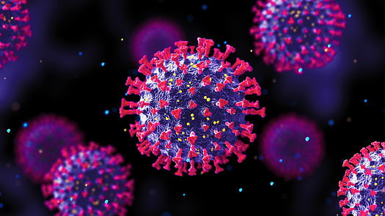

REAL-TIME INCORRECT AND TYPE OF FACEMASK DETECTION USING DEEP LEARNING
Name and STUDENT ID:
Beeharry Taajuddin(2003_19375)
Mohun Mahima(2003_19385)
Jagoo Poojan(2003_19381)
Dowlut Kawthar(2003_18517)

Slide 2
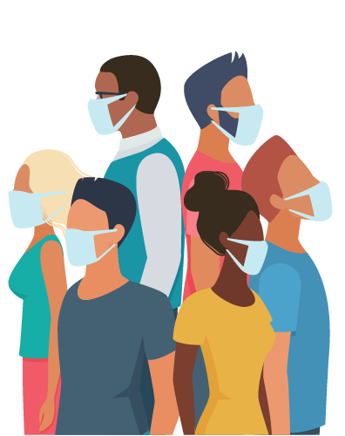
INTRODUCTION
“The surgical face mask has become a symbol of our times.” - Vanessa Friedman
The infectious coronavirus disease (COVID-19) has become a public health concern in China and beyond, since its first occurrence in Wuhan. Around the world, the pandemic is causing havoc on cultures and economics.
Wearing of masks correctly can possibly prevent the spread of COVID-19.
The proper wearing of mask prevents more than 95% of contaminated particles to enter our body while inhaling.

Slide 3
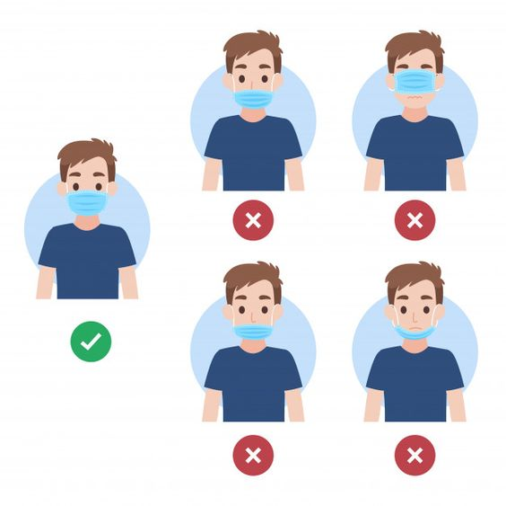
PROBLEM STATEMENT
Coronavirus infection is transmitted mostly through respiratory droplets, which are released when people breathe, talk, cough, or sneeze but airborne particles transmission rises when people speak and shout loudly.
Although wearing the mask beneath the nose is one of the most obvious mistakes, there are others that are less evident but no less critical, such as wearing the mask over spectacles or having a mask that does not fit the face properly.

Slide 4
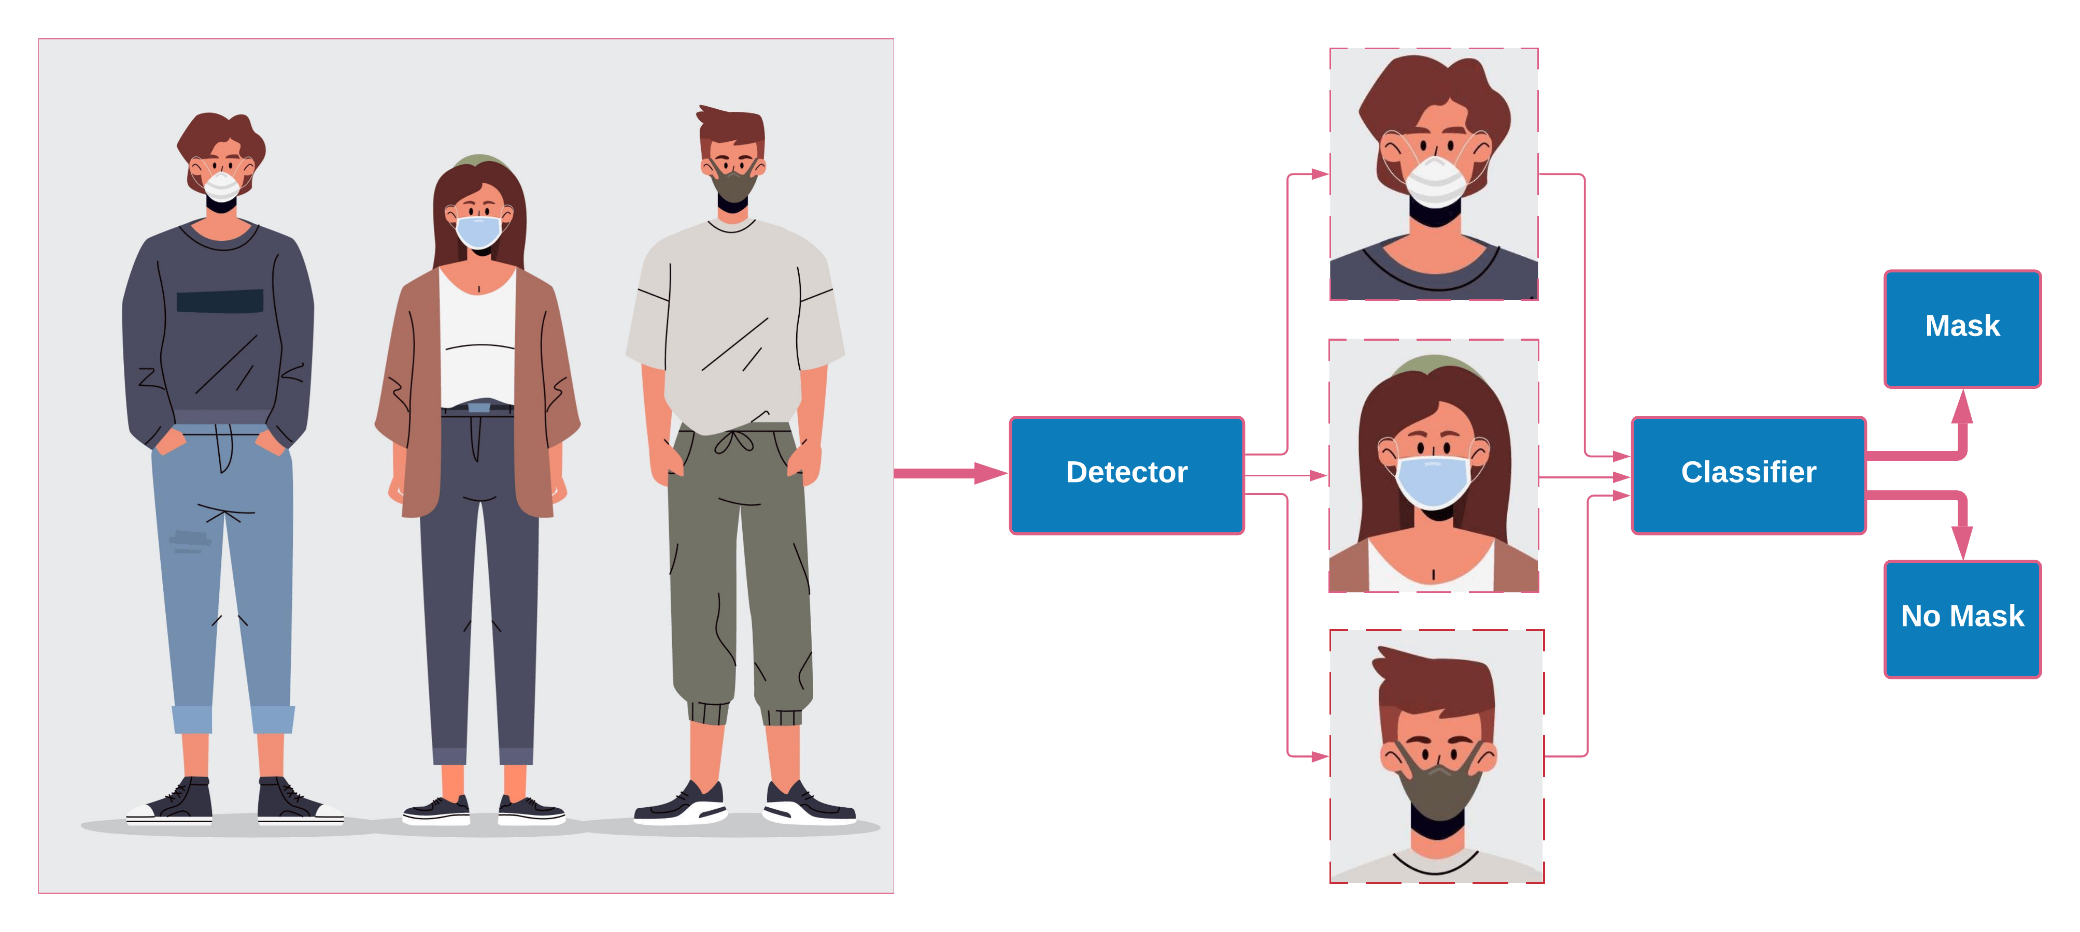

AIM
The aim of this research paper is to provide a solution by implementing more precise algorithms such as TensorFlow 1.15.2, Keras 2.3.1 and OpenCV-python 4.2.0 and Deep Learning technique to solve the problems of incorrect wearing of mask.

Slide 5


LITERATURE REVIEW
Wearing of masks correctly can possibly reduce the spread of COVID-19 by preventing contaminated particles to enter our body while inhaling.
The correct use of masks requires following general hygiene principles, the most significant of which is ensuring full mouth and nose coverage while minimizing gaps between the face and the mask.
Without the proper use of mask, people with severe health issues are proven to be more exposed to this pandemic.

Slide 6
LITERATURE REVIEW
Many software have been developed in order to solve the problems of incorrect wearing of mask. The following are some techniques which were used to implement the classification and tracking of face masks.
YOLO v3-tiny
Hybrid machine learning techniques
MobileNetV2 architecture
CNN model
Deep Learning Techniques

Slide 7

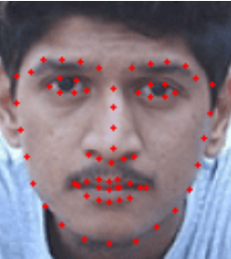
METHODOLOGY
Many people does not wear their mask correctly which result in the spreading of the virus.
Our aim has been met by using Deep Learning technique to determine whether the mask is properly positioned or not and the type of mask worn.
As a result, our software not only detect the presence or absence of a mask, but also determine whether it is properly positioned or not by the use of facial landmarks, as well as the type of mask worn.
Our software was created using PyCharm along with some libraries and dataset of 3835 images in all.

Slide 8
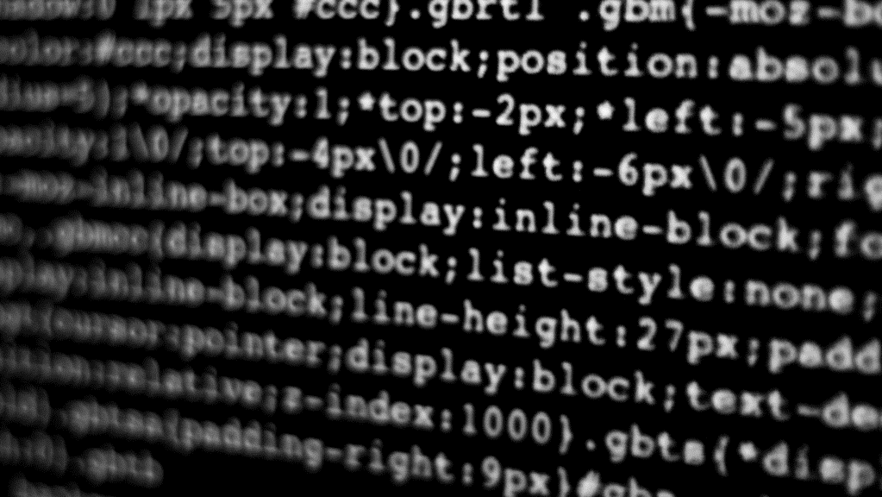


SOFTWARE DEMO
Live Demonstration of our software

Slide 9
TESTING
The testing was conducted with 10 people overall.
Whenever the mask is worn correctly, it has a high accuracy and also indicates the type of mask.
For improper face mask testing, we tested face masks under the nose and under the mouth, with various degrees of accuracy.

Slide 10
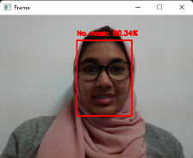
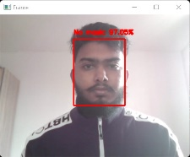
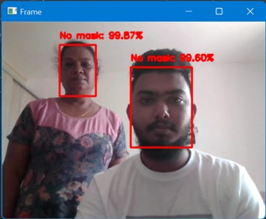
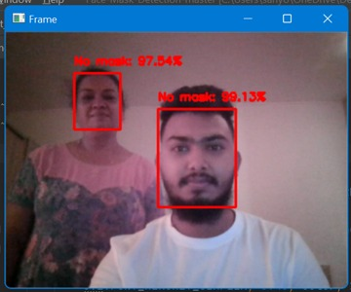
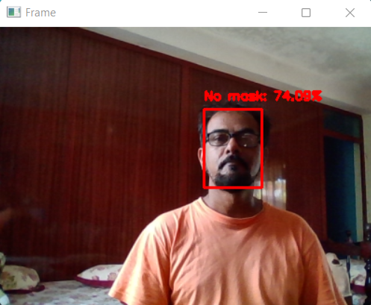
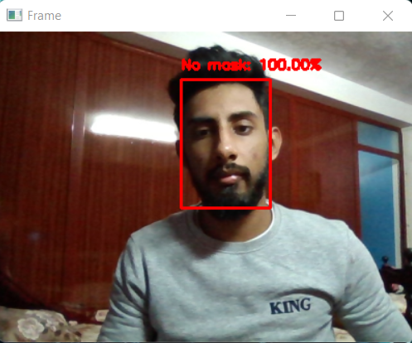
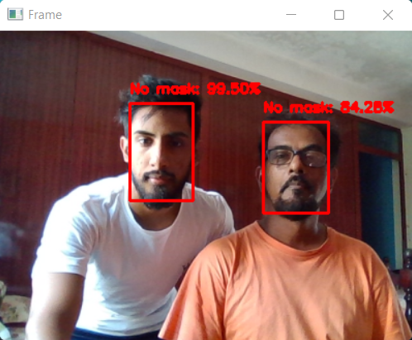
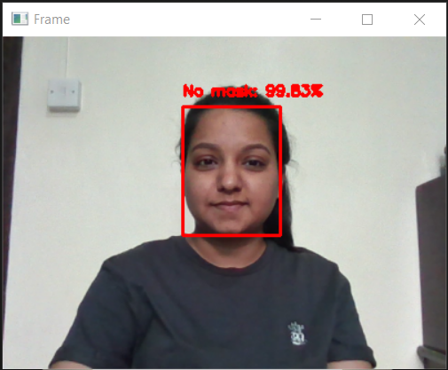
RESULT
No Mask

Slide 11
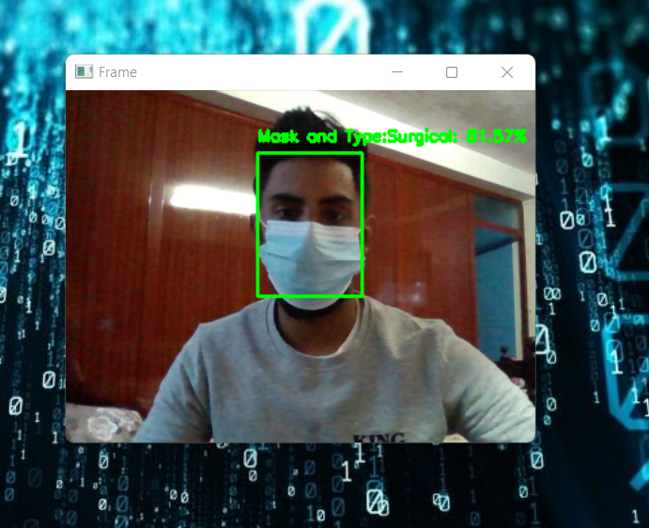
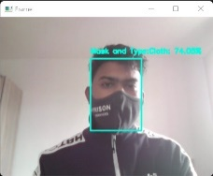
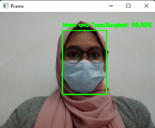
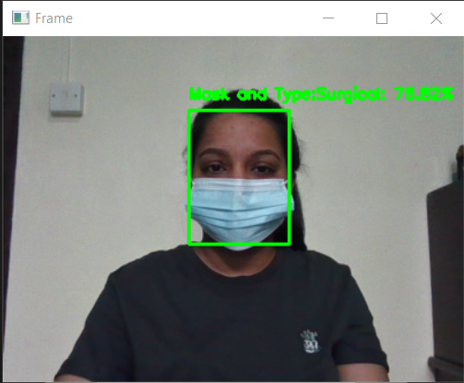
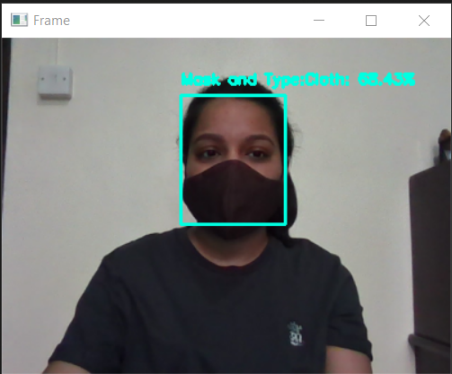
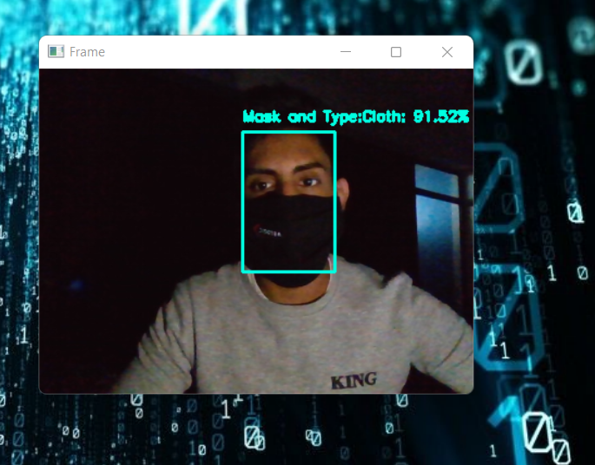
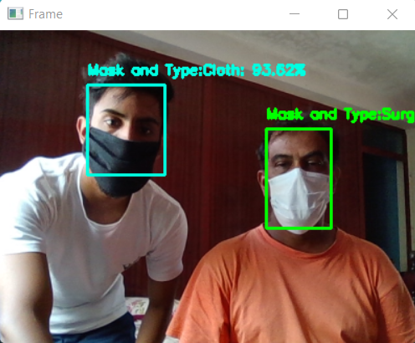
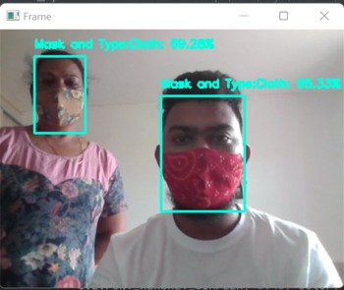
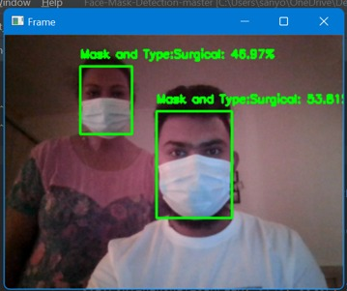
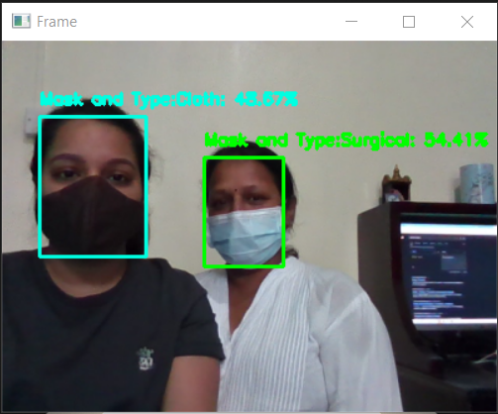
WITH MASK
Type Cloth & Surgical

Slide 12
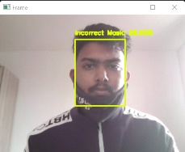
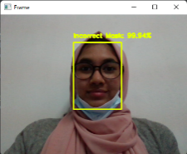
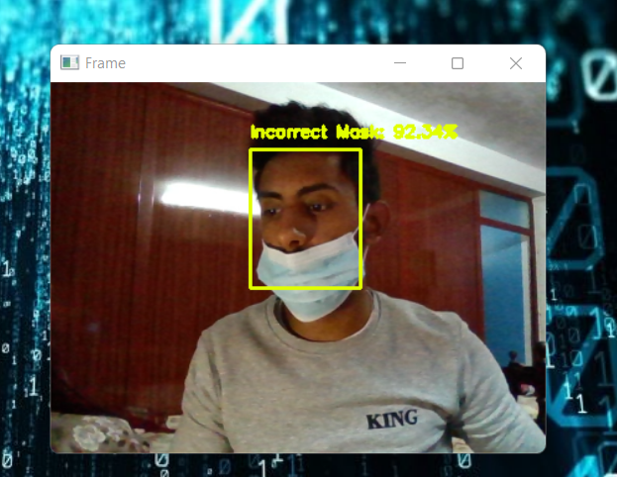
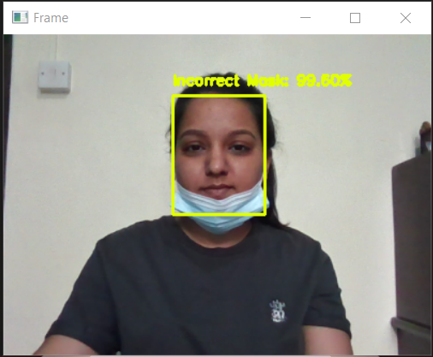
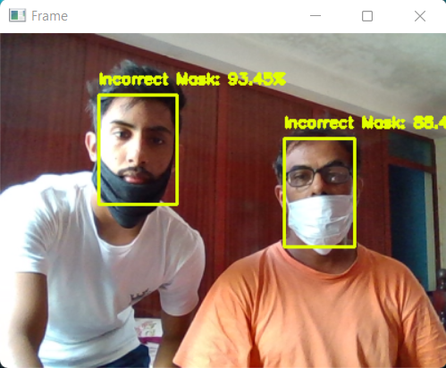
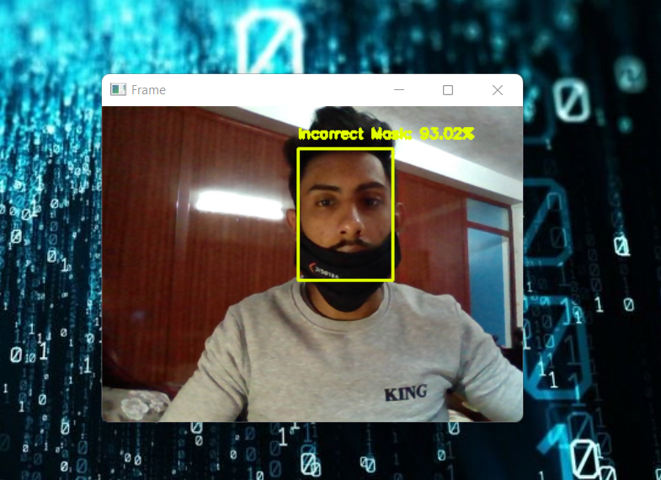
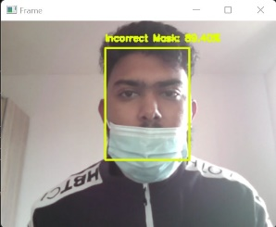
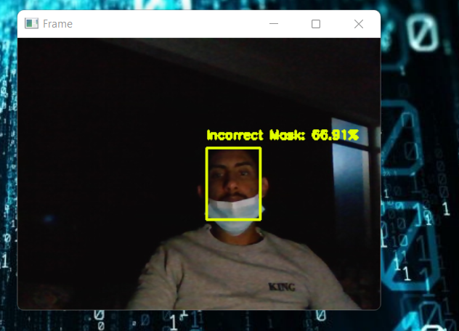
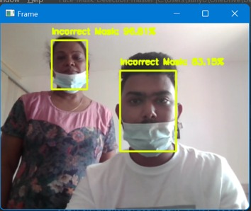
INCORRECT FACEMASK
Type Cloth & Surgical

Slide 13
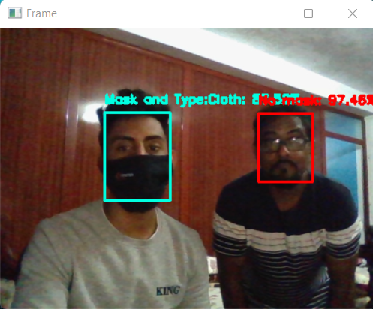
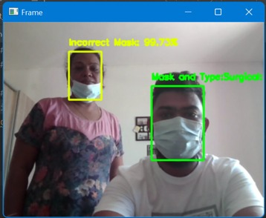
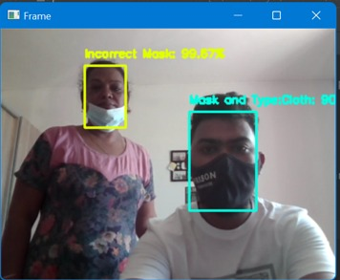
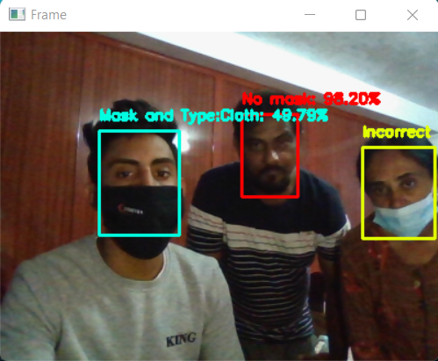
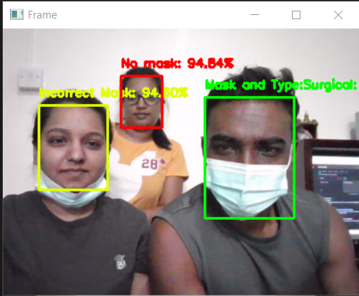
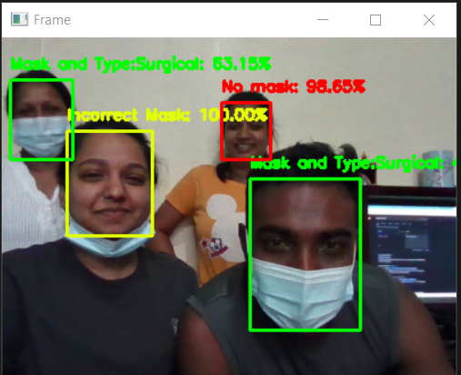
MASK, INCORRECT & NO MASK
More than 2 people

Slide 14
RESULT
Test | Gender | Age Group | Accuracy
 |  |  | No Mask | Mask and Type | Incorrect
1 | M | 20-25 | 97.05% | 74.05% | 93.30%
2 | F | 20-25 | 80.34% | 69.65% | 99.94%
3 | M | 20-25 | 100.00% | 70.98% | 95.03%
4 | F | 20-25 | 95.48% | 80.05% | 94.56%
5 | F | 30-35 | 93.89% | 91.09% | 94.08%
6 | M | 30-35 | 98.04% | 74.05% | 93.30%
7 | F | 30-35 | 97.05% | 89.65% | 99.94%
8 | M | 35-40 | 80.34% | 70.98% | 95.03%
9 | M | 40-50 | 93.56% | 80.05% | 94.56%
10 | F | 40-50 | 85.08% | 90.19% | 94.08%

Slide 15
DISCUSSION
The results obtained from the table above for incorrect facemask detection somehow matches that of what ( Adrian R., 2020) have done.
As a result, Deep Learning algorithms have been tested to tackle these issues. The most effective ways have been put to the test. The results vary depending on the network that was used.
The Deep Learning model produces the greatest outcomes (83.4% precision). This shows how video processing knowledge can be applied to the problem of determining the right type and placement of a face mask.

Slide 16
CONCLUSION
Our system can identify different forms of issues that happen frequently when using a facemask, as well as the mask's protective qualities. Many persons are ignorant to the fact that they are wearing the mask incorrectly.
The result of our proposed system perform an accuracy of 98 percent, which is quite impressive. The study is also a useful weapon in combating the spread of the COVID-19 virus because it allows everybody to wear a face mask.

Slide 17
THANK YOU

